Slide 1

OBJECT ORIENTED PROGRAMMING PROJECT
MUHAMMAD OSAMA BIN FAISAL (B19102088)
MUHAMMAD KHIZER KAMAL (B19102084)
HAMZA EJAZ (B19102041)

Slide 2
PROBLEM STATEMENT
The aim is to provide a platform for a fast-food chain in order to benefit their employees and customers.
Customers can order what they want, and employees or owners can fulfill their requirements easily, such as adding items and obtain their profit and revenue on a click.

Slide 3
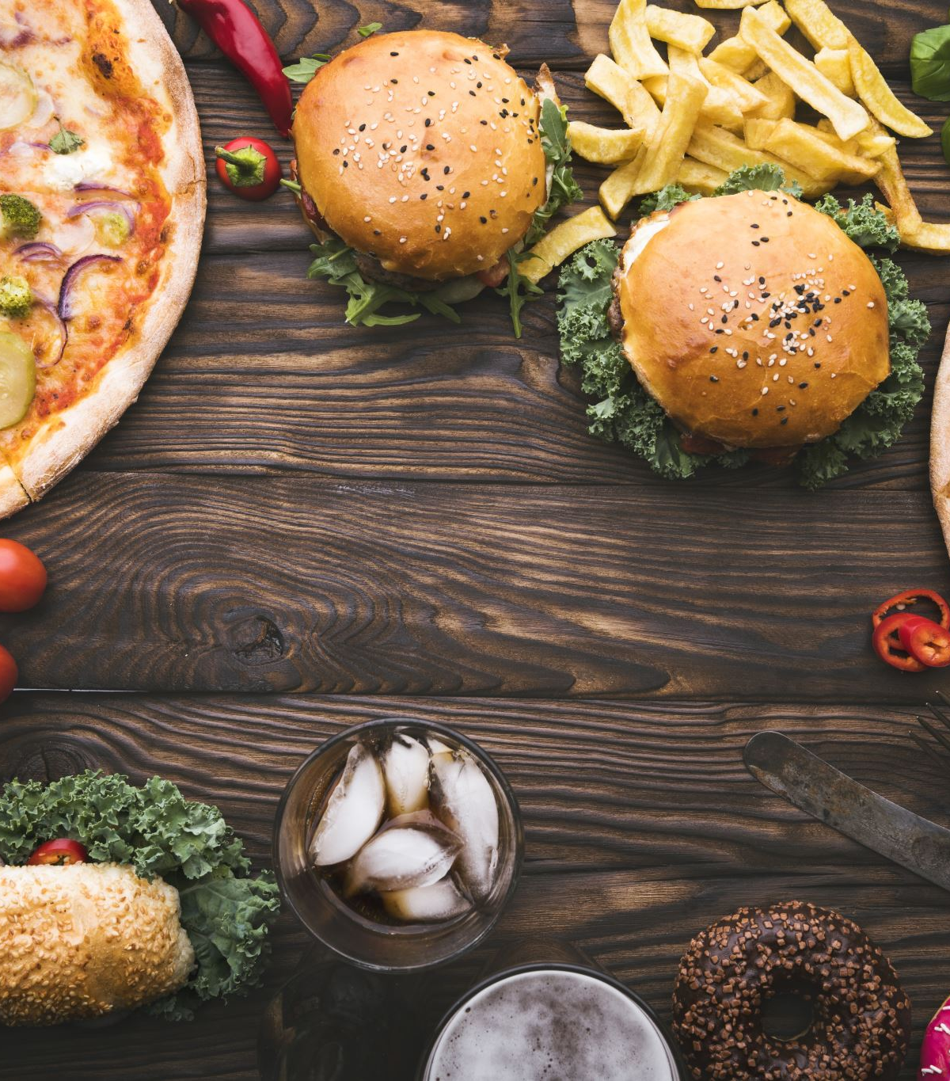
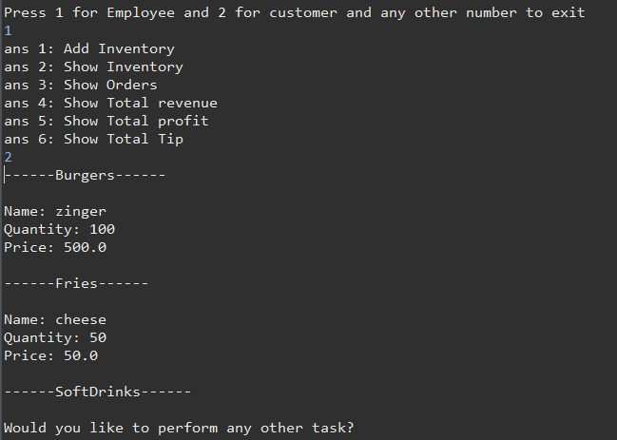
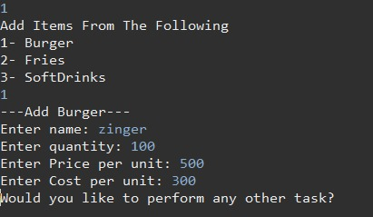
EMPLOYEE
Items can be added in the burger ,fries and soft drinks, respectively. Employees can add quantity, cost per unit. And price per unit.
employees can view the remaining items in the stock after certain operations.

Slide 4
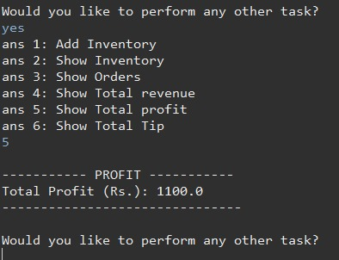
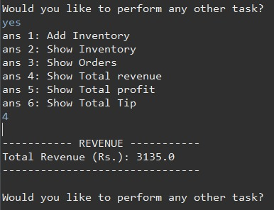
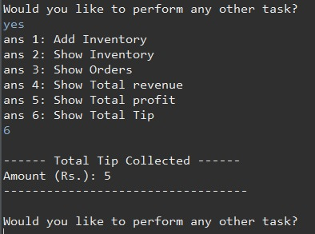
EMPLOYEE
Employees can also see the total revenue generated and profit obtained at the end of their operation time.
Employees can also see the total tip collected.

Slide 5
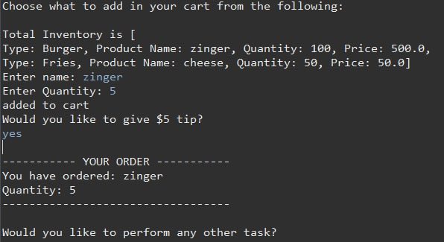
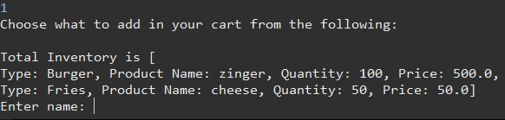
CUSTOMER
Customers can choose their favorite item from all the three categories with the quantity they require after viewing the items in the stock.
Customers can give tip on their desire.

Slide 6
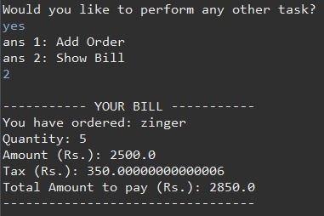
CUSTOMER
Customer can view their order and total bill inclusive of tax at the end.

Slide 7

THANK YOU

